Slide 1
Learn About Global Climate Change
2022 Climate Superstars Task #1

Slide 2
Learning Objectives
After completing this task, you will be able to…
Explain the difference between weather and climate.
Identify and describe the climate type where you live.
Cite evidence of climate change in your community.

Slide 3
Vocabulary
Climate – a description of the long-term pattern of weather in a geographic area using averages of temperature, humidity, atmospheric pressure, wind, rainfall, and other meteorological elements
Climate Change – long-term change in the average weather patterns that have come to define earth’s local, regional, and global climates
Climate Variability – short-term regional changes in temperature and weather patterns (e.g. El Niño, La Niña) resulting from natural physical processes within earth’s climate system
Global Warming – the long-term heating of earth’s climate system observed since the pre-industrial period (between 1850 and 1900) due to human activities, primarily fossil fuel burning, which increases heat-trapping greenhouse gas levels in earth’s atmosphere
Weather – a description of the short-term condition of the atmosphere in a geographic area using measurements of temperature, humidity, atmospheric pressure, wind, and precipitation

Slide 4
Weather and climate, what’s the difference? Watch this video from NASA to find out.
https://youtu.be/vH298zSCQzY

Slide 5
Climate Where You Live
Having viewed the video, "What’s the difference between weather and climate?" You now know the difference between weather and climate is a measure of time. Weather is the conditions of the atmosphere over a short period of time, and climate is how the atmosphere "behaves" over relatively long periods of time.
The most popular system of classifying climates was proposed by Russian-German scientist Wladimir Köppen. Studying vegetation, temperature, and precipitation data, Köppen and other scientists, like Rudolf Geiger, developed a system for naming climate regions
According to the Köppen-Geiger climate classification system, there are six climate zones: tropical (A), dry (B), subtropical (C), continental (D), polar (E), and highland (H).

Slide 6
Köppen-Geiger Climate Classification System
To learn about the sub-divisions of climate categories visit: https://www.weather.gov/jetstream/climate_max.

Slide 7
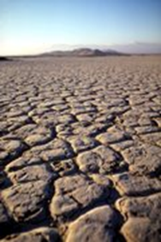
Major Climate Categories
A - Tropical Climates
Tropical moist climates extend north and south from the equator to about 15° to 25° latitude. In these climates all months have average temperatures greater than 64°F (18°C) and annual precipitation greater than 59".
B - Dry Climates
The most obvious climatic feature of this climate is that potential evaporation and transpiration exceed precipitation. These climates extend from 20°-35° north and south of the equator and in large continental regions of the mid-latitudes often surrounded by mountains.
C - Moist Subtropical Mid-Latitude Climates
This climate generally has warm and humid summers with mild winters. Its extent is from 30°50° of latitude mainly on the eastern and western borders of most continents. During the winter, the main weather feature is the mid-latitude cyclone. Convective thunderstorms dominate summer months.

Slide 8
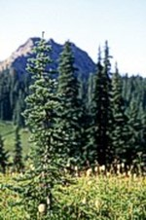
Major Climate Categories
D - Moist Continental Mid-Latitude Climates
Moist continental mid-latitude climates have warm to cool summers and cold winters. The location of these climates is poleward of the "C" climates. The average temperature of the warmest month is greater than 50°F (10°C), while the coldest month is less than -22°F (-30°C). Winters are severe with snowstorms, strong winds, and bitter cold from Continental Polar or Arctic air masses.
E - Polar Climates
Polar climates have year-round cold temperatures with the warmest month less than 50°F (10°C). Polar climates are found on the northern coastal areas of North America, Europe, Asia, and on the land masses of Greenland and Antarctica.
H - Highlands
Unique climates based on their elevation. Highland climates occur in mountainous terrain where rapid elevation changes cause rapid climatic changes over short distances.

Slide 9
Climate Change
When scientists talk about climate change, they are talking about changes in long-term averages of daily weather. Scientists studying global climate change watch the weather all over the world.
Take a few minutes to review the following sequence of data visualizations. What pattern(s) or trends do you see in the data?
To access the entire data visualization from NASA Scientific Visualization Studio, use this link: https://svs.gsfc.nasa.gov/4964.

Slide 10
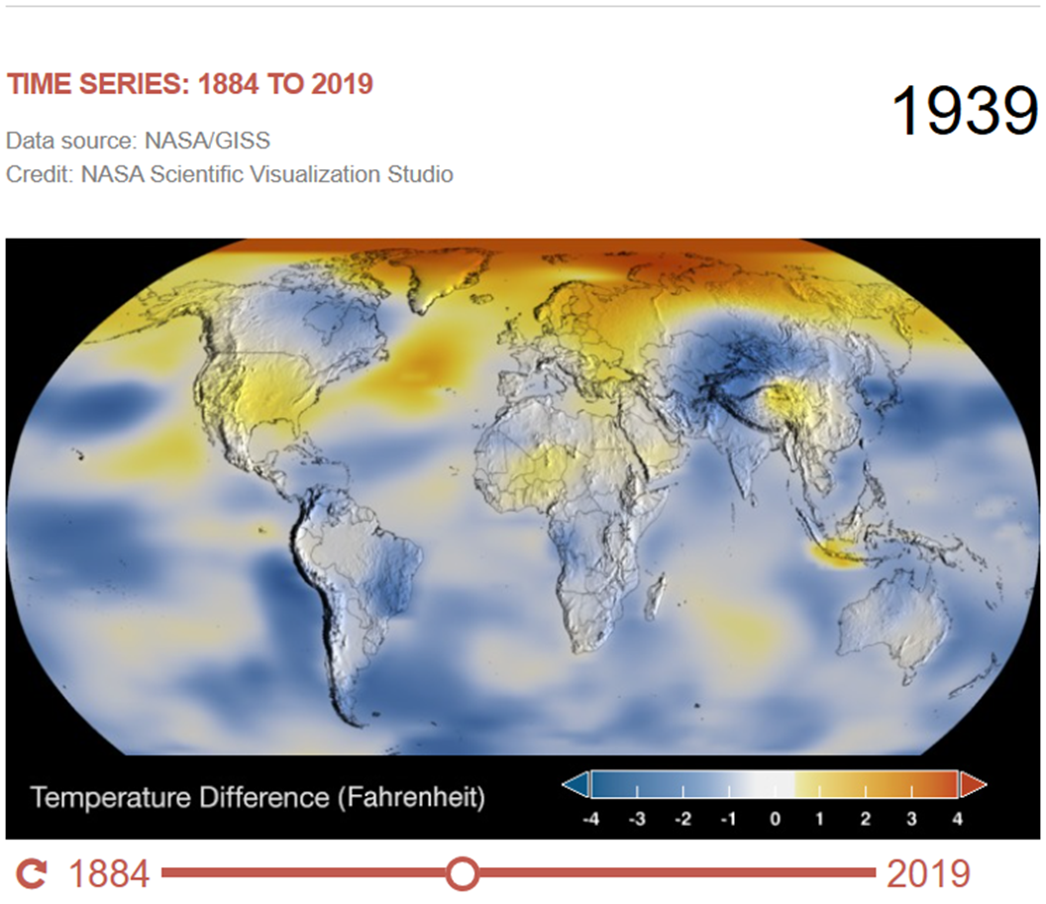
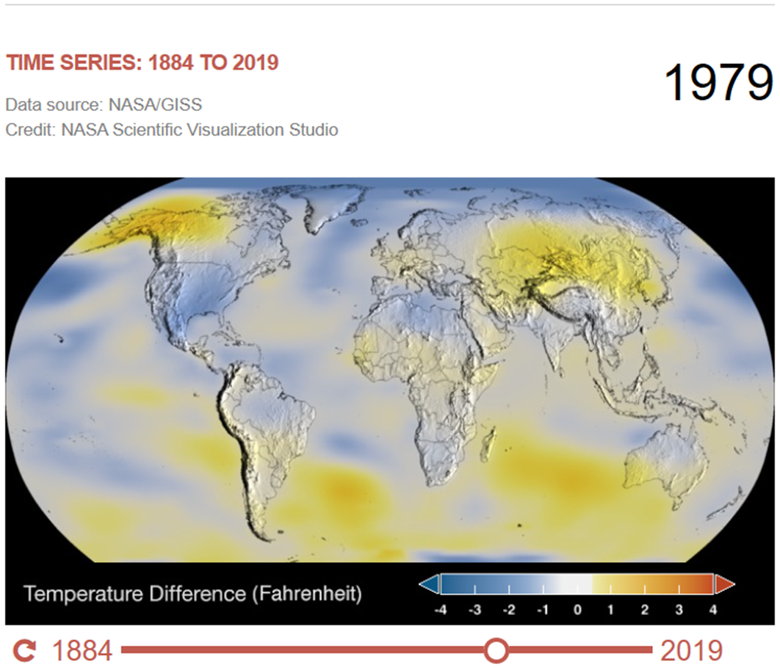
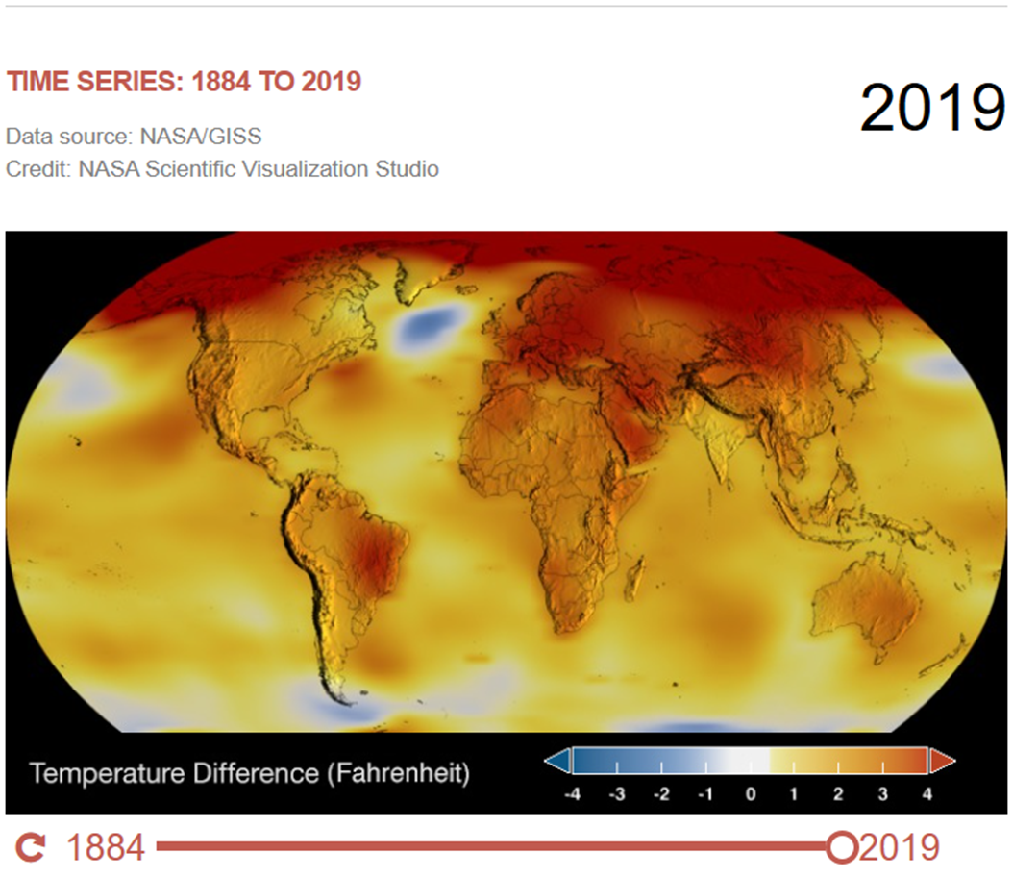
Global Temperature Differences
Normal temperatures are shown in white. Higher than normal temperatures are shown in red and lower than normal temperatures are shown in blue.

Slide 11
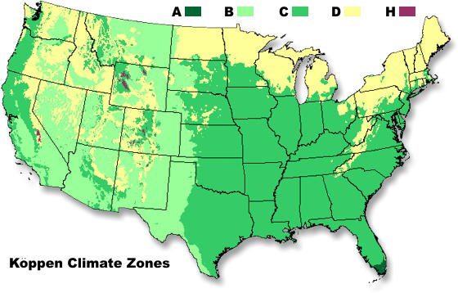
Action Item
Find where you live on the map. Using the major climate categories introduced earlier,
Describe the climate where you live.
Using what you have learned from this task,
What evidence of climate change are you aware of in your community?

