Slide 1
Take a Climate Change Tour
2022 Climate Superstars Task #3

Slide 2
Learning Objectives
After completing this task, you will be able to…
  Name locally relevant effects of climate change.
  Explain why the impacts of climate change differ by region.
  Identify cause and effect relationships for impacts of climate change.

Slide 3
Vocabulary
Cause and effect relationship – the principle that one phenomenon (the cause) makes one or more other phenomena happen (the effect); a combination of action and reaction
Climate change – long-term change in the average weather patterns that have come to define earth’s local, regional, and global climates
Phenomenon – a fact or situation that is observed to exist or happen, especially one whose cause or explanation is in question

Slide 4
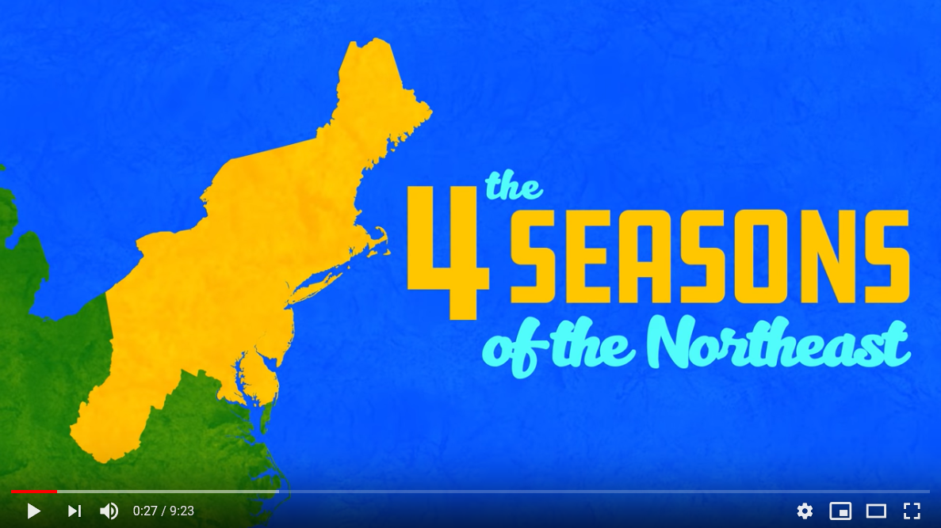
Watch one or more of the videos to learn about climate change in different regions. This video focuses on the Northeast region.
https://youtu.be/reryJb1ro2I

Slide 5
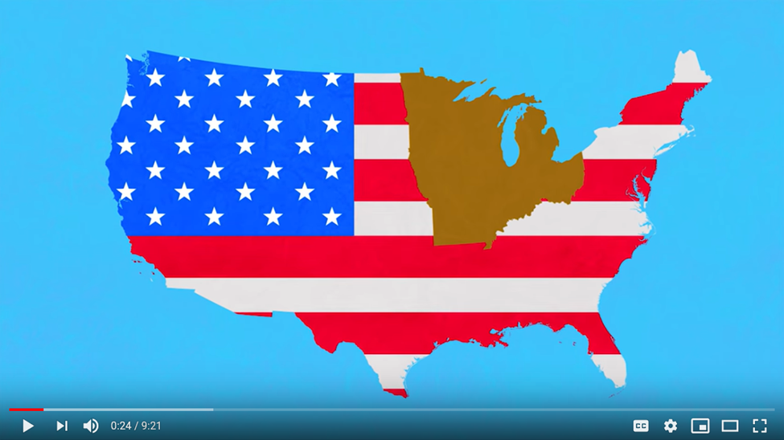
This video focuses on climate change in the Midwest and Northern Great Plains regions.
https://youtu.be/1nuGVdYo038

Slide 6
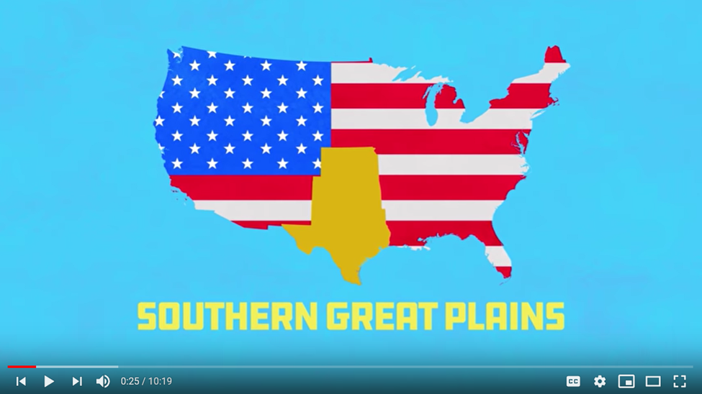
This video focuses on climate change in the Southern Great Plains region.
https://youtu.be/wd6w6mTQGwc

Slide 7
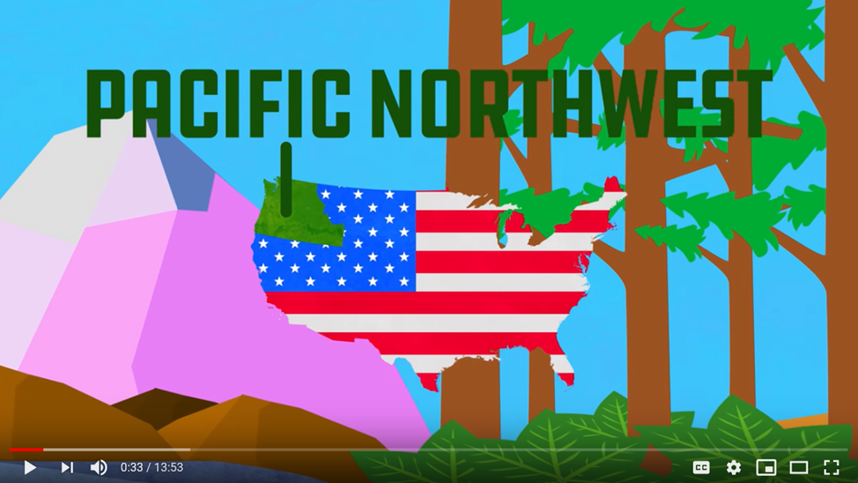
This video focuses on climate change in the Pacific Northwest region.
https://youtu.be/qRMDsMAxYGE

Slide 8
Action Item
Now that you have investigated climate change impacts by US geographic region. Starting with the region where you live, which effects of climate change are a concern in your community?
If time permits check out the impacts in other regions that interest you – perhaps where other family members live.
Which effects of climate change are a concern in your community?
Coastal Flooding / Sea Level Rise
Decreased Snowpack
Droughts
Flash Floods / Heavy Rainstorms
Heat Waves
Infectious Diseases
Ocean Acidification and Temperature Rise
Strong Tropical Storms
Wildfires
Wildlife Die-Offs / Extinctions

