Slide 1
Learn How Humans Contribute to Climate Change
2022 Climate Superstars Task #4

Slide 2
Learning Objectives
After completing this task, you will be able to…
Explain how human activities contribute to climate change.
Name several of the greenhouse gases causing global warming.
Identify cause and effect relationships for impacts of climate change.

Slide 3
Vocabulary
Climate variability – variations in climate patterns, beyond individual weather events, that occur within smaller timeframes, such as a month, a season or a year that are generally attributed to natural causes
CO2 equivalent - a unit of measurement that compares the number of metric tons of CO2 emissions with the same global warming potential as one metric ton of another greenhouse gas
Greenhouse effect – a phenomenon that occurs when gases in the atmosphere trap heat emitted by the planet
Greenhouse gases – a set of naturally occurring and man-made gases in earth’s atmosphere that trap heat, while allowing sunlight to pass through; many greenhouse gases are extremely long-lived, with some remaining airborne for tens to hundreds of years after being released

Slide 4
Watch this video from National Geographic to better understand the causes and effects of climate change.
https://youtu.be/G4H1N_yXBiA

Slide 5
Greenhouse Effect
The atmosphere’s ability to trap thermal energy or heat is called the greenhouse effect. Normally, the greenhouse effect is an essential process that keeps our planet temperate and habitable. Because human activities produce additional thermal energy and emit greenhouse gases into the atmosphere—increasing the amount of heat being trapped—global warming occurs.
The following graph shows how the rise in global temperature correlates with the rise of CO2 in the atmosphere.

Slide 6
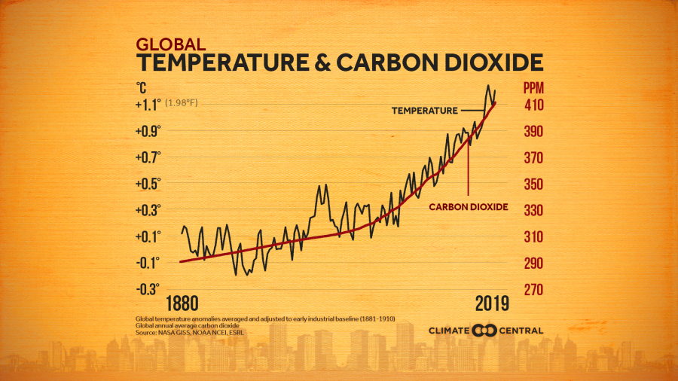
Greenhouse Effect

Slide 7
Human Activities & Climate Change
Human activities are responsible for almost all of the increase in greenhouse gases in the atmosphere over the last 150 years. The largest source of greenhouse gas emissions from human activities in the United States is from burning fossil fuels for electricity, heat, and transportation. To slow climate change, we will need to reduce greenhouse gas emissions.
Different greenhouse gases have different global warming potentials (i.e. how long they remain in the atmosphere, how strongly they absorb energy, and how they contribute to warming the earth). To make the calculations easier, scientists estimate emissions in tons of CO2 equivalent.

Slide 8
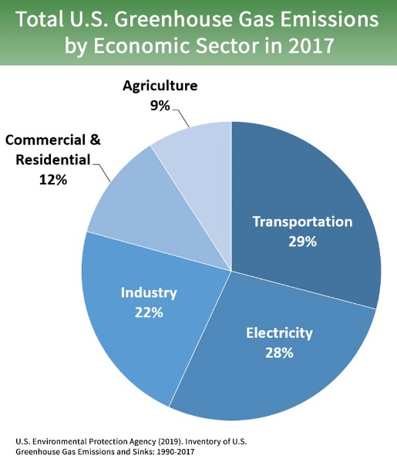
Greenhouse Gas Emissions
Using electricity, disposing of waste, driving to school, and many of our other daily activities emit greenhouse gases into the atmosphere. The greenhouse gases are water vapor (H₂O), carbon dioxide (CO₂), methane (CH₄), ozone (O₃), nitrous oxide (N₂O), and chlorofluorocarbons. Some greenhouse gases occur naturally, others are man-made.

Slide 9
Action Item
Using information presented in this task as evidence answer the following questions:
Which human activity contributes the most greenhouse gas emissions?
Which greenhouse gas emission correlates with the rise in average global temperature?
Answer #1
_________________________________________________________
Answer #2
_________________________________________________________

