Slide 1
Learn About Renewable Energy
2022 Climate Superstars Task #6

Slide 2
Learning Objectives
After completing this task, you will be able to…
Explain the difference between renewable and non-renewable energy sources.
State the main benefit of renewable energy.
Explain why there are different mixes of renewables used in generating electricity based on location.

Slide 3
Vocabulary
Biomass – is burned directly in steam-electric power plants, or it can be converted to a gas that can be burned in steam generators, gas turbines, or internal combustion engine generators
Geothermal – uses steam turbines connected to a generator
Hydropower – uses flowing water to spin a turbine connected to a generator
Solar – two types: photovoltaic (PV) and solar-thermal power; PV conversion produces electricity directly from sunlight, a solar-thermal power system uses steam turbines connected to a generator
Wind – uses moving air to spin a turbine connected to a generator

Slide 4
Watch this short video to find out what the benefits of renewable energy are and how it can help humans combat climate change.
https://youtu.be/1kUE0BZtTRc

Slide 5
Benefits of Renewable Energy Sources
Wind, waves, tides, sunlight, geothermal heat, and biomass are sources of energy that are replenished without human intervention and on a human timescale. That is why energy derived from these sources is called renewable. Renewables can replace conventional fuels such as oil, coal, and natural gas in electricity generation, heating, transportation, and off-grid energy services.
Renewable energy sources play an important role in reducing greenhouse gas emissions. Using renewable energy to generate electricity can reduce the use of fossil fuels, a major source of greenhouse gas emissions.
Use the following graphs to discover the mix of energy sources used to generate electricity in different regions of the country.

Slide 6
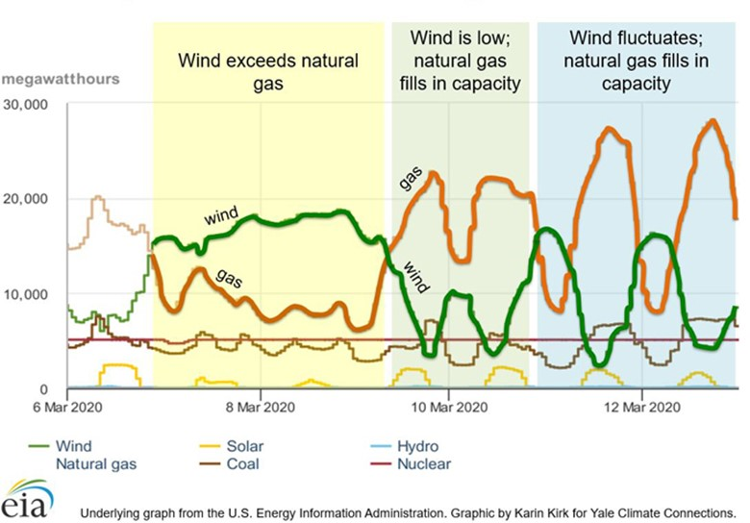
Texas Electricity Generation by Energy Source
In Texas, wind-based generation leads, natural gas generation follows.

Slide 7
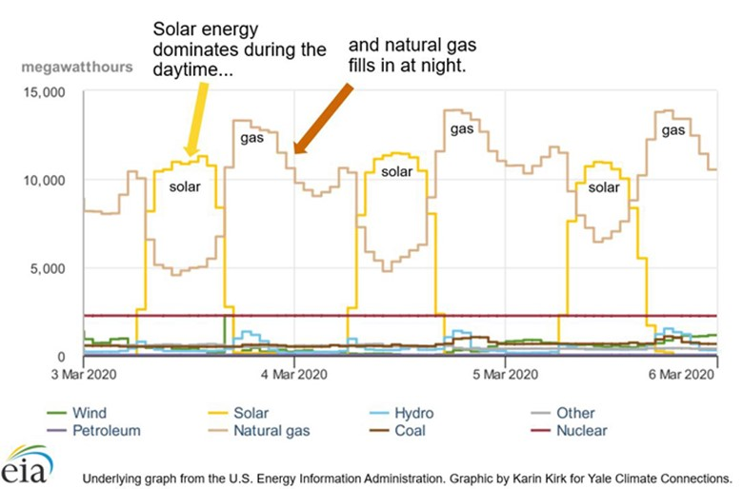
California Electricity Generation by Energy Source
In California, solar energy supplies electricity during the day, natural gas at night.

Slide 8
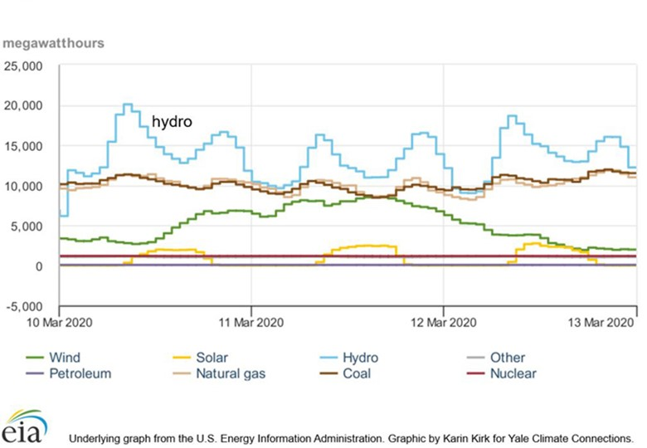
Northwest Electricity Generation by Energy Source
In the Pacific Northwest, hydro-based generation leads, natural gas and coal follow close behind.

Slide 9
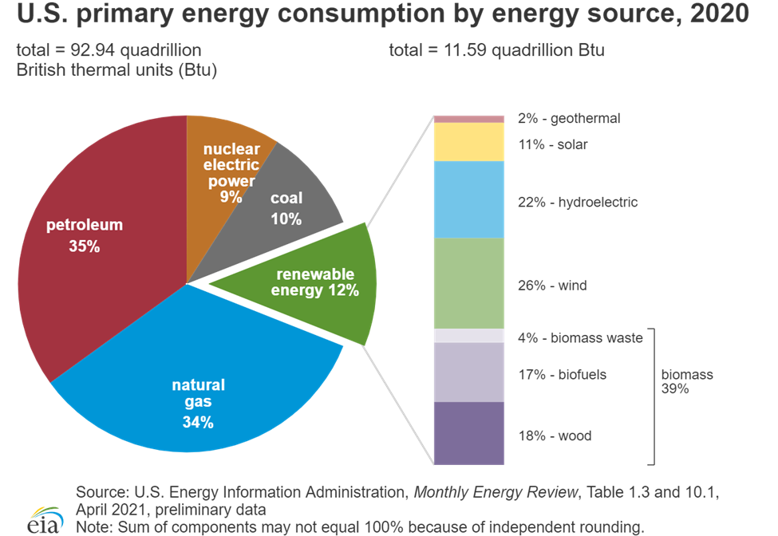
US Energy Consumption by Energy Source

Slide 10
Action Item
Do some research to learn the following:
How much renewable energy does your local power plant or utility use to produce electricity?
Check all that apply.
How does your local energy mix compare to the overall averages for the United States as a whole?
Local energy mix to generate electricity:
Biomass
Geothermal
Hydropower
Solar
Wind

