Slide 1
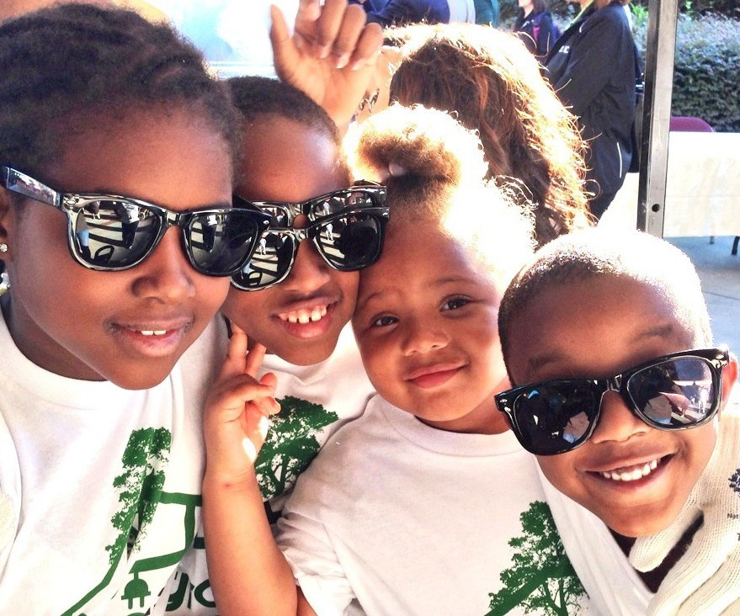
9/23/23
Celebrate 30 Years of Care & Commitment
Local Event Information
Find us on

