Slide 1
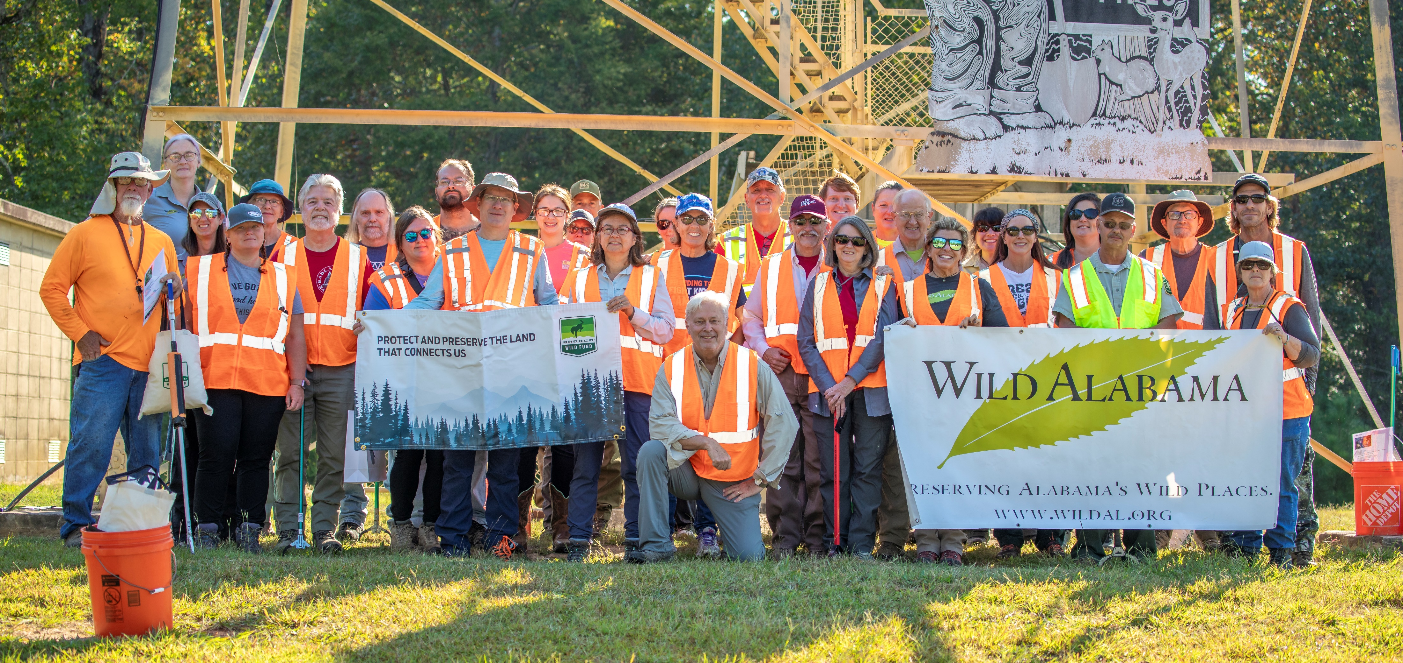
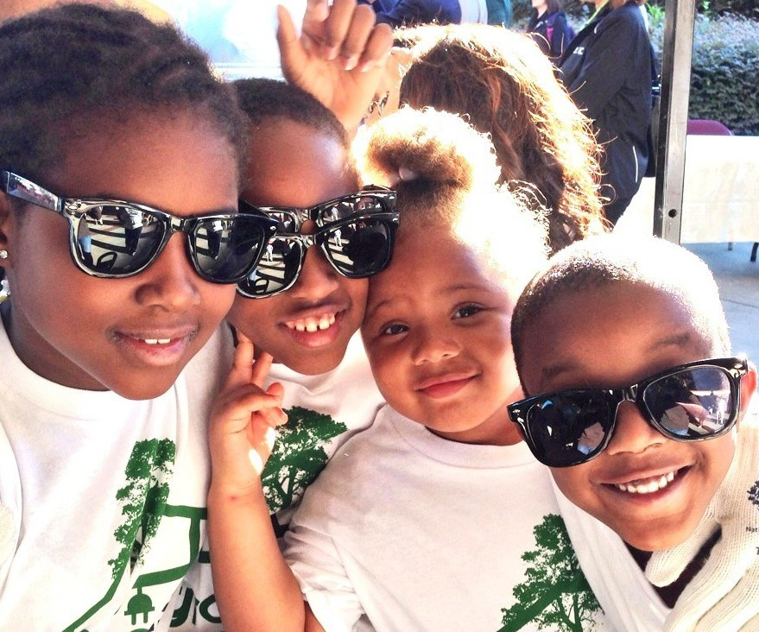
9/28/24
Together for Tomorrow
Local Event Information
Find us on

