Slide 1
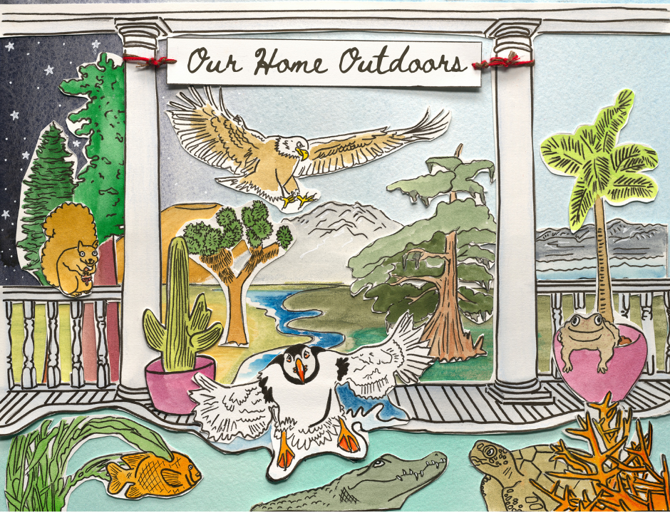
National Public Lands Day
Local Event Information
Celebrate Public Lands
9/27/25
Find us on

