Slide 1
What are the Best Types of Renewable Energy? – Part 2
2022 Climate Superstars Task #8

Slide 2
Learning Objectives
After completing this task, you will be able to…
  Explain the difference between renewable and green energy sources.
  State the main benefits of green energy.
  Explain why lifecycle analysis of renewables helps clarify which energy technologies are the greenest.

Slide 3
Vocabulary
Conventional power - includes the combustion of fossil fuels (coal, natural gas, and oil) and the nuclear fission of uranium. Fossil fuels have environmental costs from mining, drilling, or extraction, and they emit greenhouse gases and air pollution during combustion. Although nuclear power generation emits no greenhouse gases during power generation, it does require mining, extraction, and long-term radioactive waste storage.
Green power - a subset of renewable energy. It represents those renewable energy resources and technologies that provide the greatest environmental benefit. Green power is defined as electricity produced from solar, wind, geothermal, biogas, eligible biomass, and low-impact small hydroelectric sources.
Lifecycle analysis - used to assess the overall greenhouse gas (GHG) impacts of a fuel, including each stage of its production and use.
Renewable energy - resources that rely on fuel sources that restore themselves over short periods of time and do not diminish. Such fuel sources include the sun, wind, moving water, organic plant and waste material (eligible biomass), and the earth's heat (geothermal).

Slide 4
Comparing Renewable Energy Sources
In the Learn About Renewable Energy activity, several types of energy were introduced. The graphic on the next slide organizes them according to their respective beneficial environmental impacts.
This activity continues exploring and answering the question, what are the best types of green power? Your analysis will now include hydropower in the mix. For you to come up with an answer requires looking at both the benefits and impacts of the various types.
Hydropower in its various forms harnesses the kinetic energy of moving water. Humans have been using the flow of water to produce mechanical energy to grind grain, saw lumber, and power machinery used in manufacturing. Hydropower was one of the first sources of energy used for electricity generation.

Slide 5
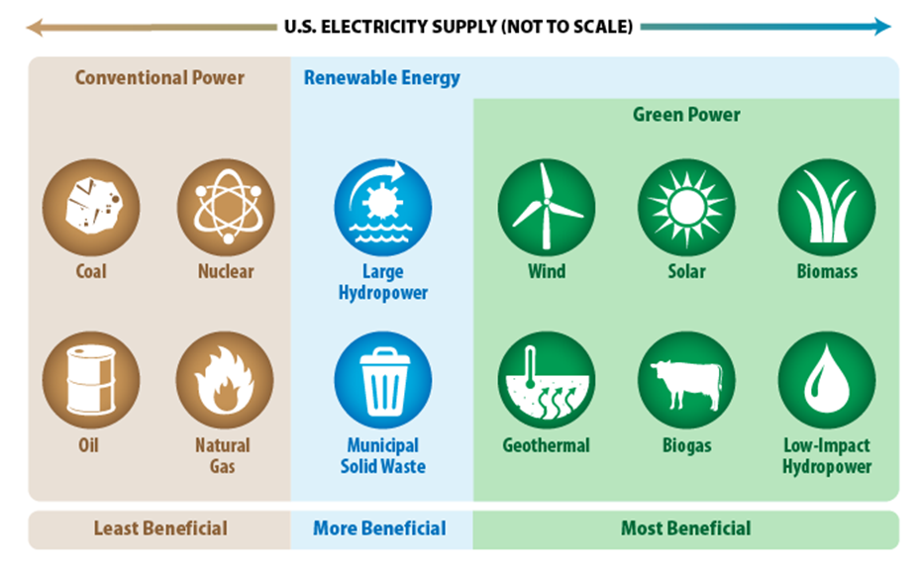
Relative Environmental Benefits of Energy Sources
Source: EPA

Slide 6
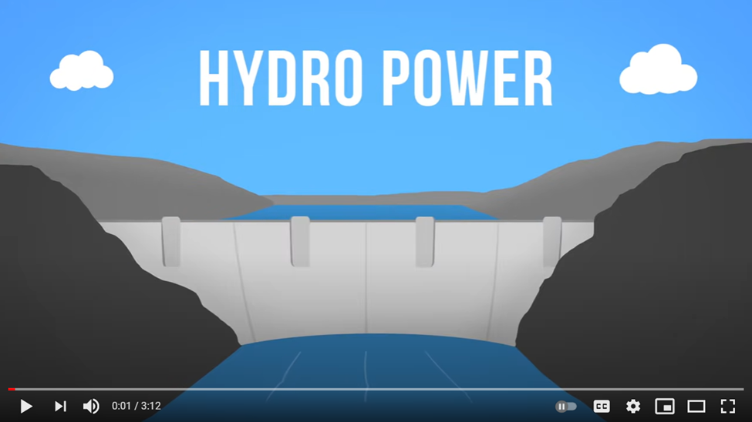
Watch this video explainer to learn about the renewable energy source called hydropower.
https://www.youtube.com/watch?v=q8HmRLCgDAI

Slide 7
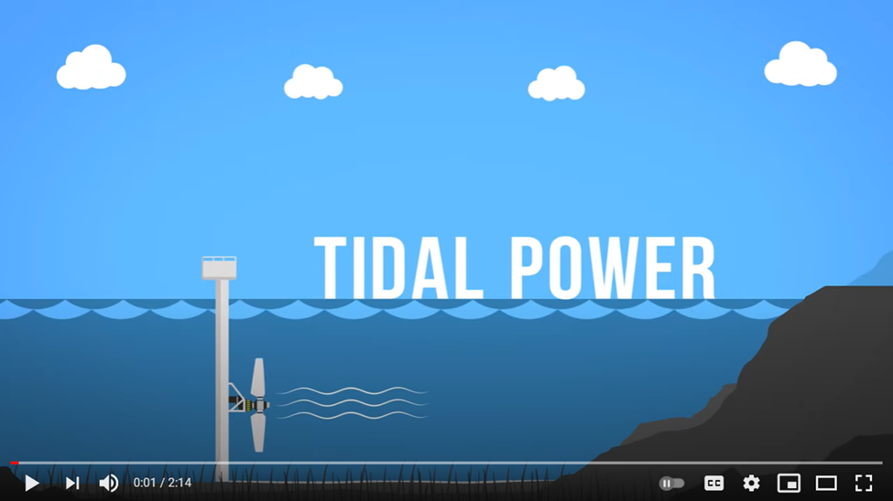
Watch this video to learn about a new way -- tidal power -- of using the properties of moving water to produce electricity.
https://www.youtube.com/watch?v=VkTRcTyDSyk

Slide 8
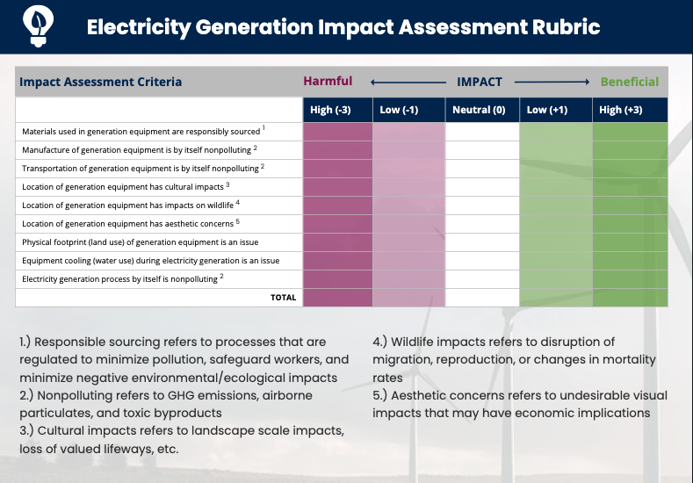
Action Item
Complete an Electricity Generation Impact Assessment Rubric (next slide) for hydropower energy.
Then debate the pros and cons of hydropower energy versus other renewable energy types. Use your set of Electricity Generation Impact Assessment Rubrics from Task 7 as evidence to evaluate which type of renewable energy is the greenest.

