Slide 1


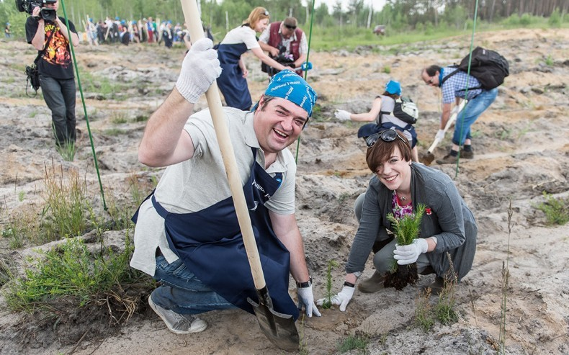
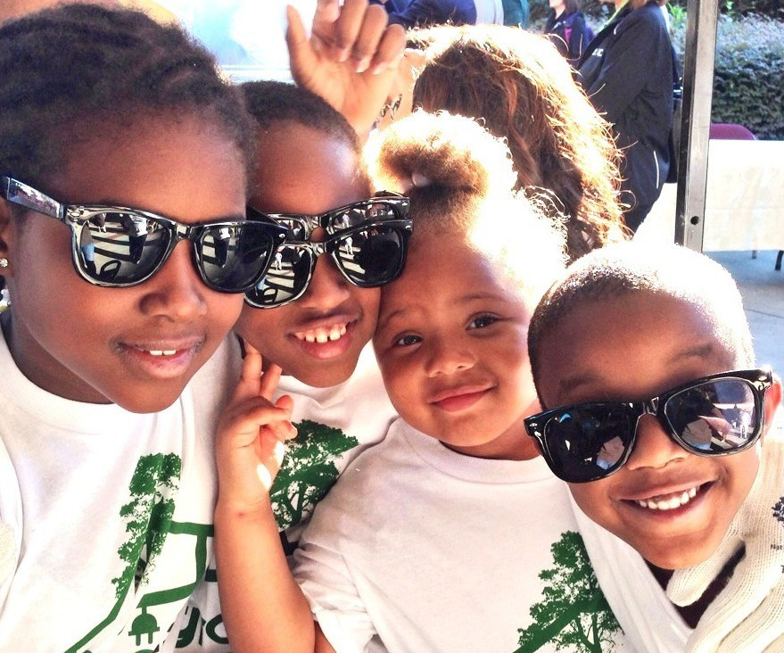




9/24/22
is the day for
giving back together
Local Event Information
Find us on

